Slide 1
Update from Program & Service Management Office
Status update on processes and projects
Presented by Jerree Catlin, Scott Kemme, Sue Silkey, Thelma Simons and Mike Wright

Slide 2
ITIL Service Management
Change
Management
Service Level
Management
Release
Management
Financial
Management
Incident
Management
Availability
Management
Service
Support
Service
Delivery
Configuration
Management
Problem
Management
IT Service Continuity
Management
Capacity
Management
Service
Desk
Program & Service Management Office
Page<number>
Notes:
Last fall we gave you a quick overview of the different processes involved in ITIL best practices. Today we are going to give an update on processes tied to Service Support, as well as a few projects we are working on.

Slide 3
Best Practices Implementation
Change
Management
Project Portfolio
Management
Problem
Management
Incident
Management
Communication Plan
Service Level
Management
Configuration
Management
Project Mulligan
(Remedy)
Program & Service Management Office
Page<number>
Notes:
Today we want to give you an update on some of the processes and projects we are working on.

Slide 4
Configuration Management
Service Catalog
Configuration
Management
Monitoring
(Nagios, Orion)
Service Level
Agreements
Service
Desk
Remedy
(Incident, Problem,
Change)
Service Level
Management
SLAs
Callback List
Hardware/
Software
CMDB
Program & Service Management Office
Page<number>

Slide 5
Change Management
Change Request
Incident
Management
Problem
Problem
Management
Change Review Board
Change
Management
Incident
Configuration
Management
CMDB
Program & Service Management Office
Page<number>

Slide 6
Project Portfolio Management
Goal:
Implement project portfolio management processes and toolset
Status:
Completed preliminary list of projects
Researching toolsets
Program & Service Management Office
Page<number>
Notes:
Mike gives this part

Slide 7
Project Portfolio Management
Next Steps:
Finalize interim storage for list of projects
Finalize interim “evergreen” process for list of projects
Complete research of toolsets
Arrange demonstrations
Toolset selection
Program & Service Management Office
Page<number>

Slide 8
Communication Plan
Goal:
Maintain two-way communication with management and IS staff regarding processes and projects.
Status:
Building plan based on best practices.
Scheduling communication sessions.
Next steps:
Schedule ITIL overview for for IS staff.
Expand best practices and project information on PSMO web site.
Program & Service Management Office
Page<number>
Notes:
Mike presents

Slide 9
Change Management
Goal:
Establish standard process for efficient and prompt handling of all changes.
Status:
Processes for change requests are being defined by change management sub-committee.
Next steps:
Provide report to full change management committee.
Establish change management process with current tool (Syschng).
Program & Service Management Office
Page<number>
Notes:
Mike presents

Slide 10
Incident Management
Goal:
To restore normal service operation as quickly as possible based on best practices.
Status:
Initial phase - gathering requirements and identifying stakeholders/decision makers.
Program & Service Management Office
Page<number>
Notes:
Sue presents

Slide 11
Incident Management
Next Steps:
Create interim Incident Management process
  Define service names
  Define additional fields necessary
  Define callback list
  Develop processes to work with interim database
  Export data to interim CMDB
  Create “evergreen” process
Develop permanent process.
  Schedule kickoff meeting.
Program & Service Management Office
Page<number>

Slide 12
Problem Management
Goal:
To minimize the adverse impact and/or recurrence of incidents. Problem Management seeks to get to the root cause and initiate action to remove the error based on best practices.
Status:
Initial phase - gathering requirements and identifying stakeholders
Next Steps:
Finalize requirements
Schedule kickoff meeting
Program & Service Management Office
Page<number>
Notes:
Sue presents

Slide 13
Project Mulligan (Remedy)
Goal:
Successful implementation of most recent version of Remedy using best practices processes for incident, change, problem, and configuration management.
Status:
Draft project plan completed.
Program & Service Management Office
Page<number>
Notes:
Scott presents

Slide 14
Project Mulligan - Remedy
Next steps:
Schedule discussion with stakeholders to finalize scope.
Finalize project plan.
Investigate overview of new version of AR system and modules (Remedy).
Stabilize current environment.
Program & Service Management Office
Page<number>

Slide 15
Configuration Management
Goal:
To provide a central repository for tracking changes to the environment (hardware, software, and associated documentation).
Status:
Updating Operations Access database with accurate information.
Developing project plan.
Next Steps:
Research more robust interim database (Oracle).
Determine permanent tool.
Program & Service Management Office
Page<number>

Slide 16
Service Level Management
Goal:
Establish process to maintain and improve IT Service quality. (Includes service catalog and service level agreements.)
Status:
Present information on SLM.
Gather initial data.
Create web pages about SLM and Service Catalog.
Next steps:
Develop pilot for fee-based service listings.
Program & Service Management Office
Page<number>
Notes:
Thelma presents

Slide 17
Questions?
Program & Service Management Office
Page<number>

Slide 18
What is a Service Catalog and Why Should I Care?
Presented by Thelma Simons
Program & Service Management Office

Slide 19
What is a Service Catalog?
A Service Catalog provides a clear description of all services offered and includes details about each service, e.g. who is able to use the service, who to contact for support, services hours and location, etc.
Program & Service Management Office
Page<number>

Slide 20
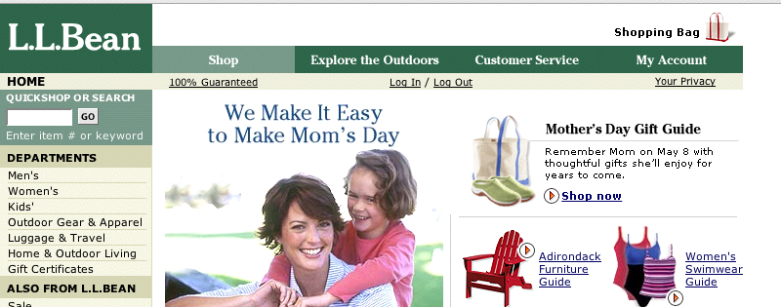
Think L.L. Bean
Program & Service Management Office
Page<number>

Slide 21
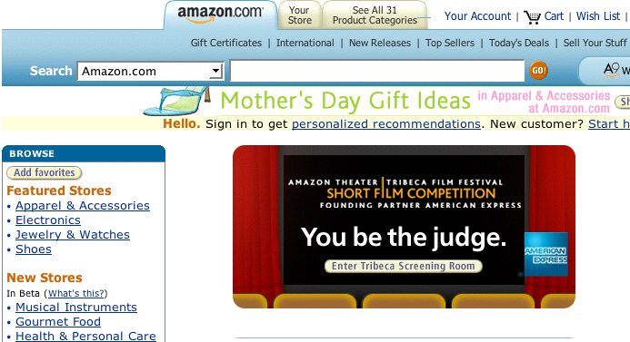
Amazon
Program & Service Management Office
Page<number>

Slide 22

Or Sprint
Program & Service Management Office
Page<number>

Slide 23
A Little Role Playing
You are a department chair and you want:
An account for a departmental web site
Assistance creating the web site
Authentication for certain areas of the web site using the KU Online ID
Program & Service Management Office
Page<number>

Slide 24
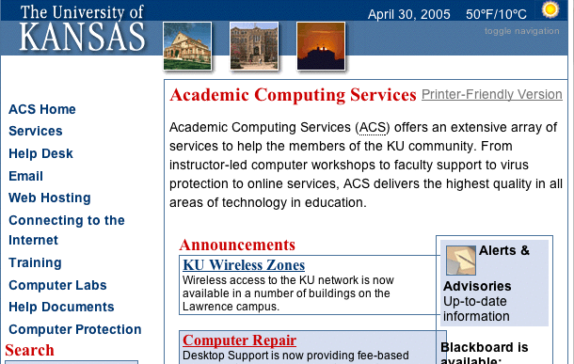
Where do you go?
Program & Service Management Office
Page<number>

Slide 25
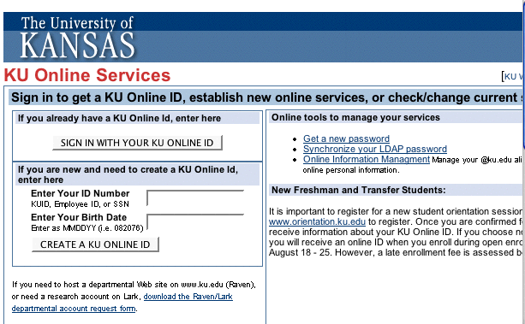
Where do you go?
Program & Service Management Office
Page<number>

Slide 26
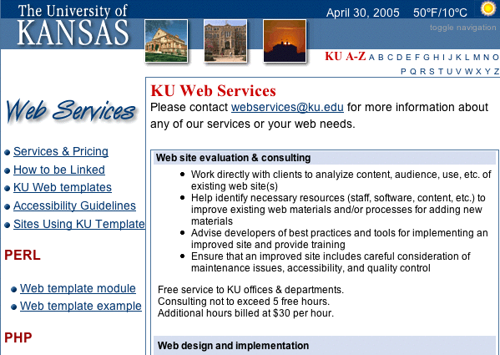
Where do you go?
Program & Service Management Office
Page<number>

Slide 27
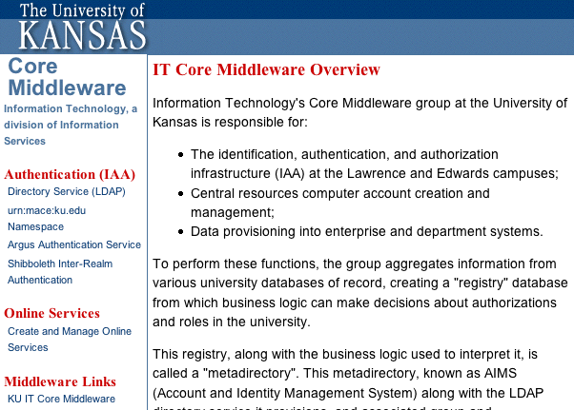
Where do you go?
Program & Service Management Office
Page<number>

Slide 28
Or, do you…
Call anyone you know at the Computer Center and see if they can tell you who can answer your question.
Program & Service Management Office
Page<number>

Slide 29
How about a better alternative?
A Service Catalog can:
Provide one location for campus users to find information about all IT services provided.
Help communicate IT’s capabilities to the university.
Program & Service Management Office
Page<number>

Slide 30
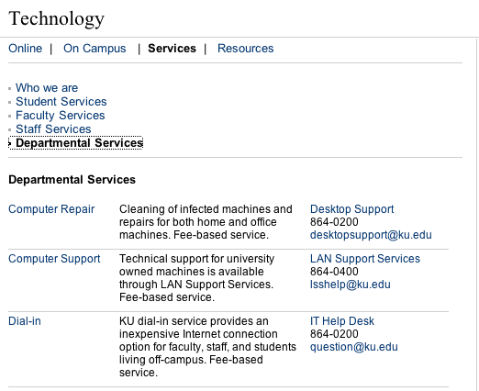
How about a better alternative?
www.ku.edu/technology
Program & Service Management Office
Page<number>

Slide 31
A Service Catalog is
Part of a larger process called Service Level Management
Program & Service Management Office
Page<number>

Slide 32
Service Level Management
Service Level Management (SLM) is an IT “best practice” process that includes an ongoing review of services.
SLM includes measuring, reporting, reviewing and improving services.
Program & Service Management Office
Page<number>

Slide 33
Value of Service Level Mgmt.
SLM establishes - and keeps open - regular lines of communication between IT and users.
SLM helps design services to meet the needs of campus users.
Program & Service Management Office
Page<number>

Slide 34
Components of SLM
Service
Catalog
Service
Level
Agreements
Operational
Level
Agreements
Underpinning
Contracts
Program & Service Management Office
Page<number>

Slide 35
Components of a Service Catalog
Service
Listing
Service
Details
Service
Level
Agreement
Program & Service Management Office
Page<number>

Slide 36
Service listing
Name of service
Short description
Who to contact
Program & Service Management Office
Page<number>

Slide 37
Service details
Description
Main users
Functionality
Availability
User support
Costs
Program & Service Management Office
Page<number>

Slide 38
An example
Service list
Service details
Program & Service Management Office
Page<number>

Slide 39
Service Catalog Project Highlights
Create service details for all currently displayed services.
Create Service Level Agreements for all fee-based services (pilot project) by early August.
Gather information on other services not currently listed.
Promote, revise, and improve.
Program & Service Management Office
Page<number>

Slide 40
How you can be involved
Review the current listing and let me know if you provide a service that is not currently listed.
The next time someone calls you about a service, direct them to the service listing at www.ku.edu/technology.
Program & Service Management Office
Page<number>

Slide 41
More info
For more information on Service Level Management go to www.ku.edu/~psmo/itil/slm
To see the current list of services go to www.ku.edu/technology
Program & Service Management Office
Page<number>

Slide 42
Wrap up
Program & Service Management Office
Page<number>

Slide 43
ITIL Service Management
Change
Management
Service Level
Management
Release
Management
Financial
Management
Incident
Management
Availability
Management
Service
Support
Service
Delivery
Configuration
Management
Problem
Management
IT Service Continuity
Management
Capacity
Management
Service
Desk
Program & Service Management Office
Page<number>
Notes:
Last fall we gave you a quick overview of the different processes involved in ITIL best practices.

Slide 44
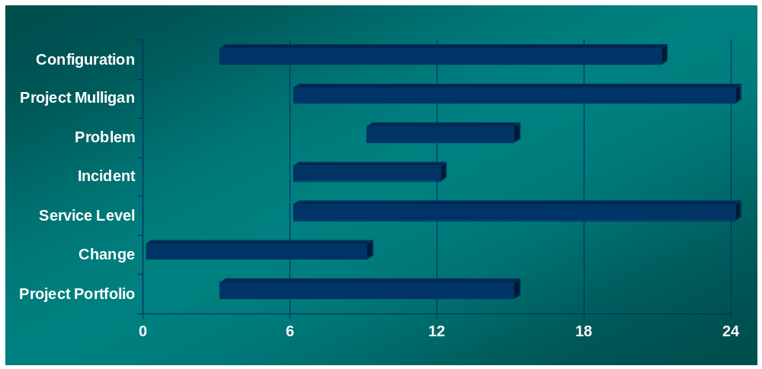
Estimated Timelines
Program & Service Management Office
Page<number>

Slide 45
Questions?
Program & Service Management Office
Page<number>

